Slide 1

TRAVEL PACKAGE WEBSITE
By : DON P D
VAS22MCA-2020

Slide 2

Table of contents
1. Problem statement
2. Objectives
3. Scope of project
4. software used.
5. Module wise description.
6. Forms
7. Reports
8. Conclusion
9. Future scope.

Slide 3


Problem statement
Travel package website aims to revolutionize the way travelers plan and book their trips by providing a seamless and personalized experience.
We want to address the challenges faced by travelers in finding comprehensive and reliable information about destinations, accommodations, activities, and transportation options.
Our goal is to create a platform that not only simplifies the travel planning process but also offers packages tailored to individual preferences, budget constraints, and travel goals. By leveraging technology and data-driven insights, we seek to enhance customer satisfaction, increase bookings, and establish ourselves as a trusted and go-to resource for travelers worldwide

Slide 4

Objectives
Enhance User Experience: Improve website usability, navigation, and design to create a seamless and enjoyable experience for users browsing and booking travel packages.
Comprehensive Information: Provide detailed and accurate information about destinations, accommodations, activities, transportation options, and pricing to help users make informed decisions and plan their trips effectively.

Slide 5

Real-Time Availability and Pricing : Display real-time availability status for travel dates, accommodations, and activities, along with transparent pricing information and any applicable discounts or promotions.
Streamlined Booking Process: Optimize the booking process to be straightforward and efficient, with minimal steps and clear instructions at each stage

Slide 6

Scope of project
Centralized platform for Travel agents :
Creating a centralized platform where travel agents can showcase their services and offerings.
Each travel agent has a dedicated profile page with information about their company, contact details and specialties .
Users can browse through different travel agents, compare services, read reviews, and make informed decisions about which agent to engage with.
Booking Process:
Enable users to select a desired travel package and proceed to the booking process.

Slide 7
Real-Time Availability and Confirmation:
Ensure that the booking system reflects real-time availability of travel packages.
Upon successful booking, provide users with instant confirmation of their reservation along with booking details and a booking reference number.
Filtering Options:
Providing users with robust filtering options to narrow down their search for travel packages based on specific criteria.
Users can easily refine their search results to find packages that align with their preferences and requirements, enhancing their overall booking experience.

Slide 8

software configuration
• Operating System: Windows 7 and above
• Web Server: Express.js
• Language: JavaScript
• Front End: React.js
• Back End: Node.js
• Database: MongoDB
• IDE: Visual Studio Code
• Framework: MERN (MongoDB, Express.js, React.js, Node.js)

Slide 9
Module wise description
Admin Module :
Manage users : Admin can view and remove users.
Approve agents : Agents need to be approved by the admin.
Manage packages : Admin can view and remove packages.
Generate reports : Admin can generate pdf reports such as bookings, categorized packages etc.

Slide 10
Agent Module :
Register : Agent can Register account .
Login : Agent can login to his account .
Add packages : Agent can add travel package .
Give booking approval : Gives Approval to booking request given by customer
Profile : Agent can view his profile .
Manage packages : Agent can view and remove his personal packages .

Slide 11
user Module:
Register : User can register account.
Login : User can login to his personal account.
View profile : User can view his personal profile.
View packages : User can view uploaded packages.
Filter packages : User can use filters to view desired packages.
Add to wish list : User can add package to wish list.
Book packages : User can book package after adding to wish list.
View booking status : User can view booking status is approved by travel agent.

Slide 12
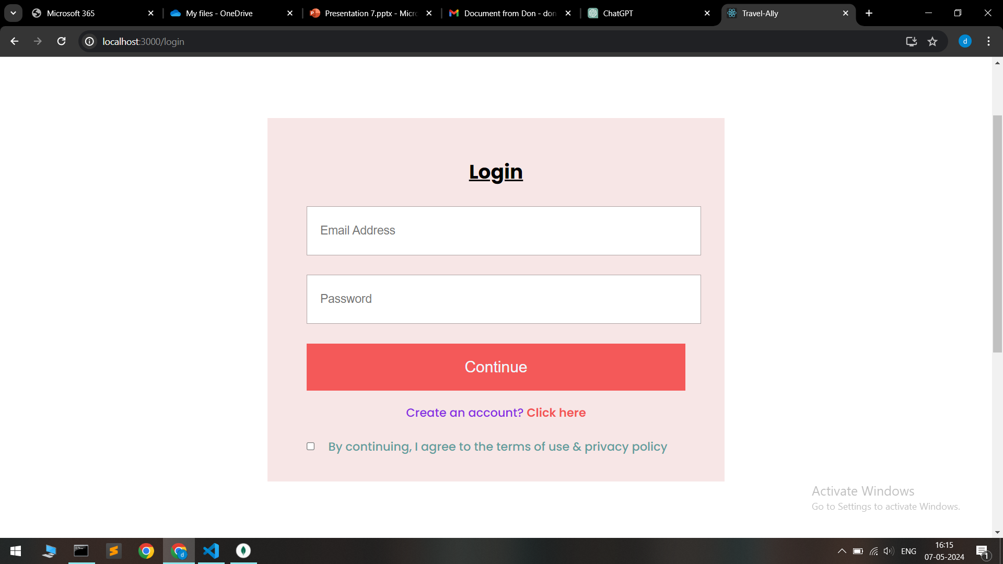
Login form

Slide 13
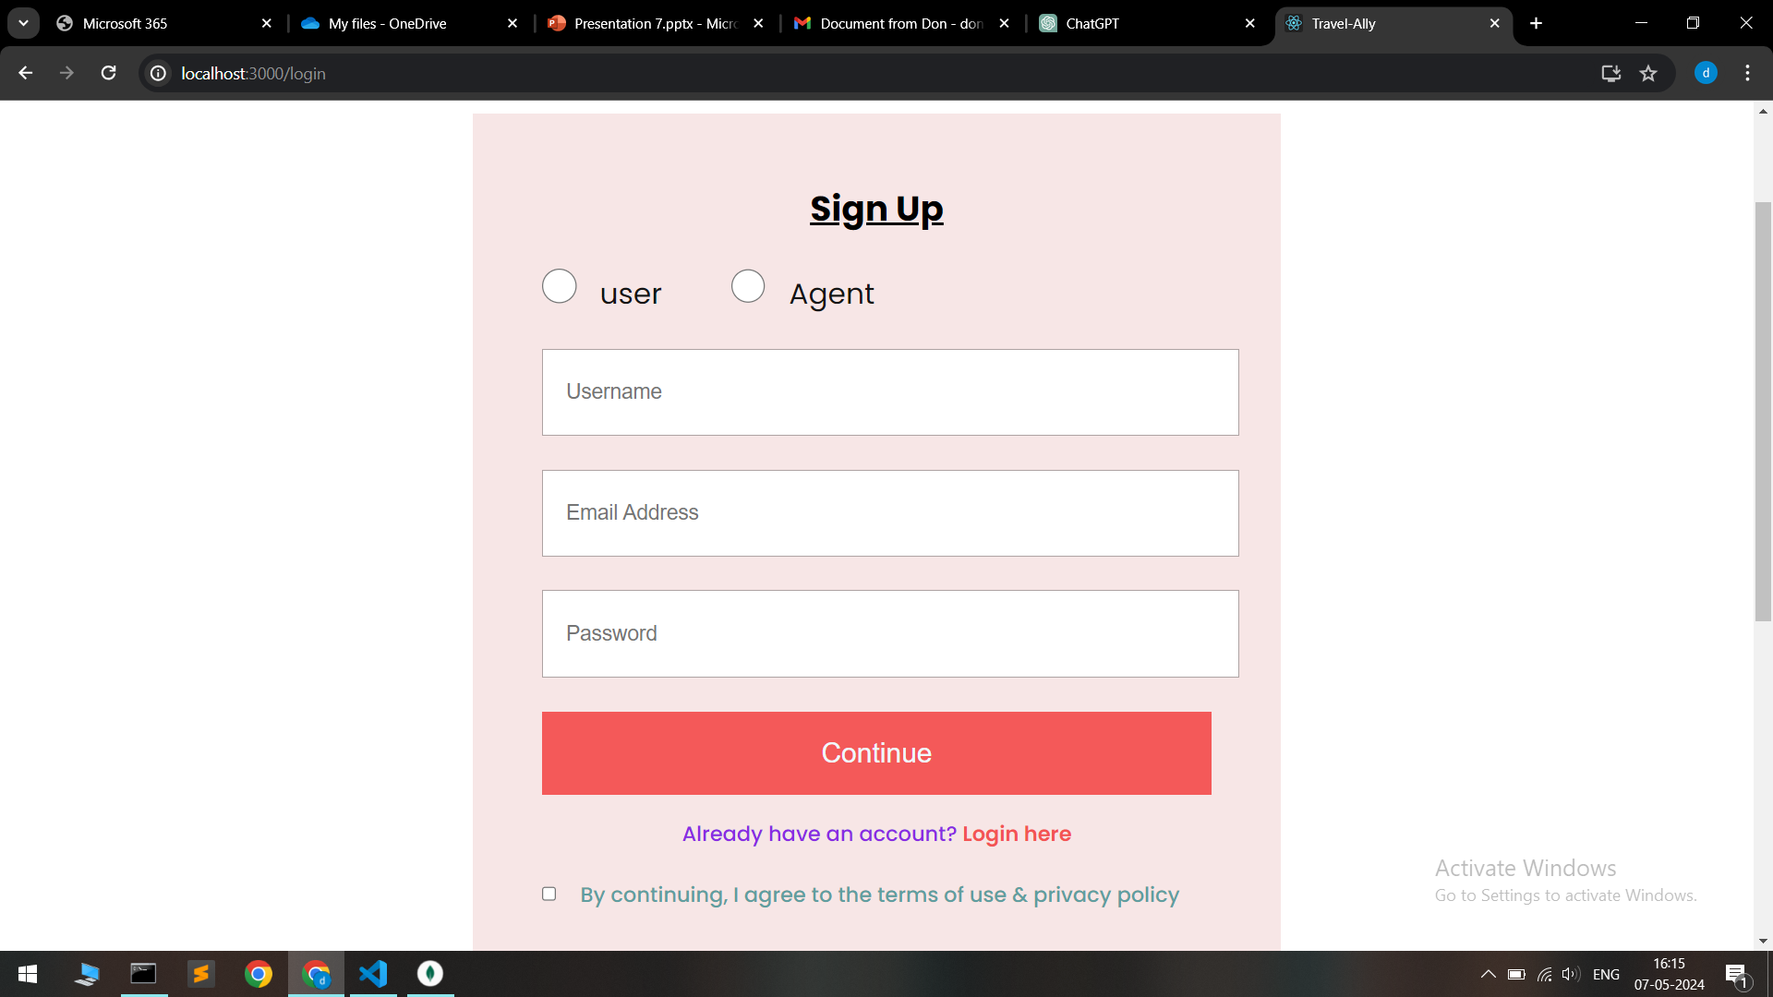
Register form

Slide 14
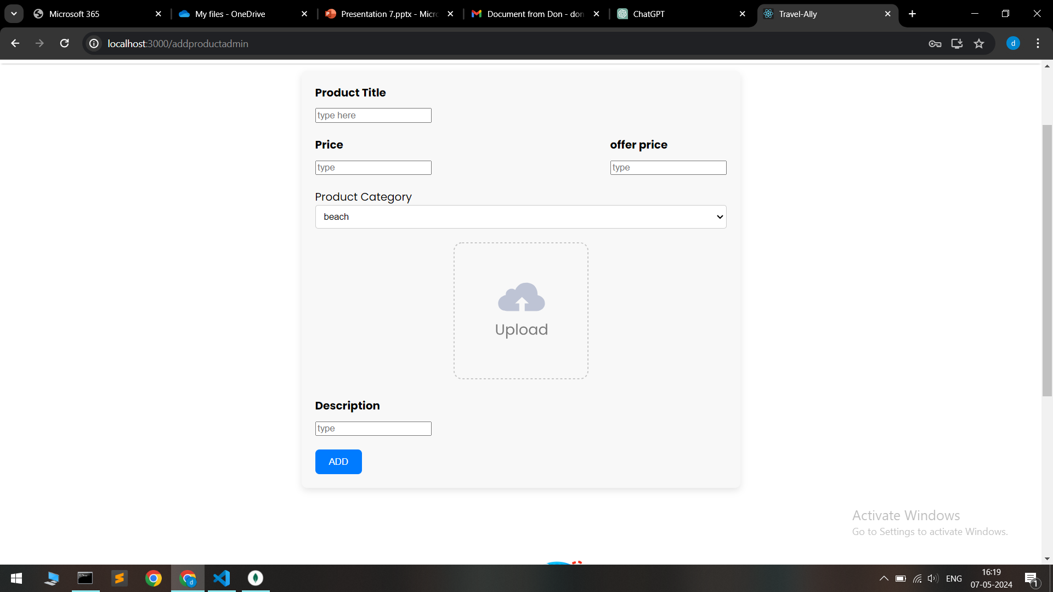
Add package

Slide 15
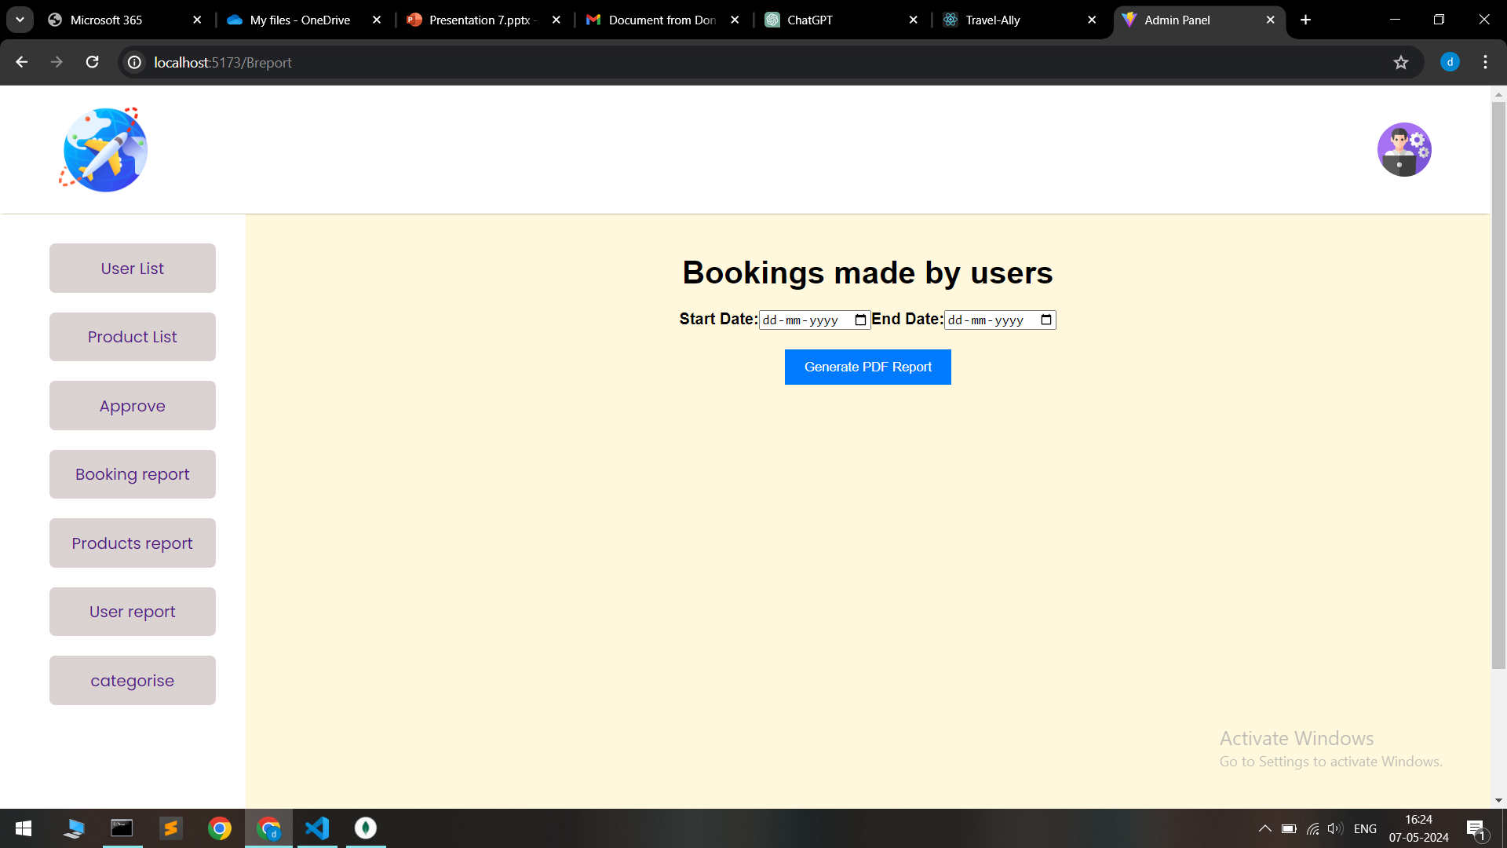
Generate Booking report

Slide 16
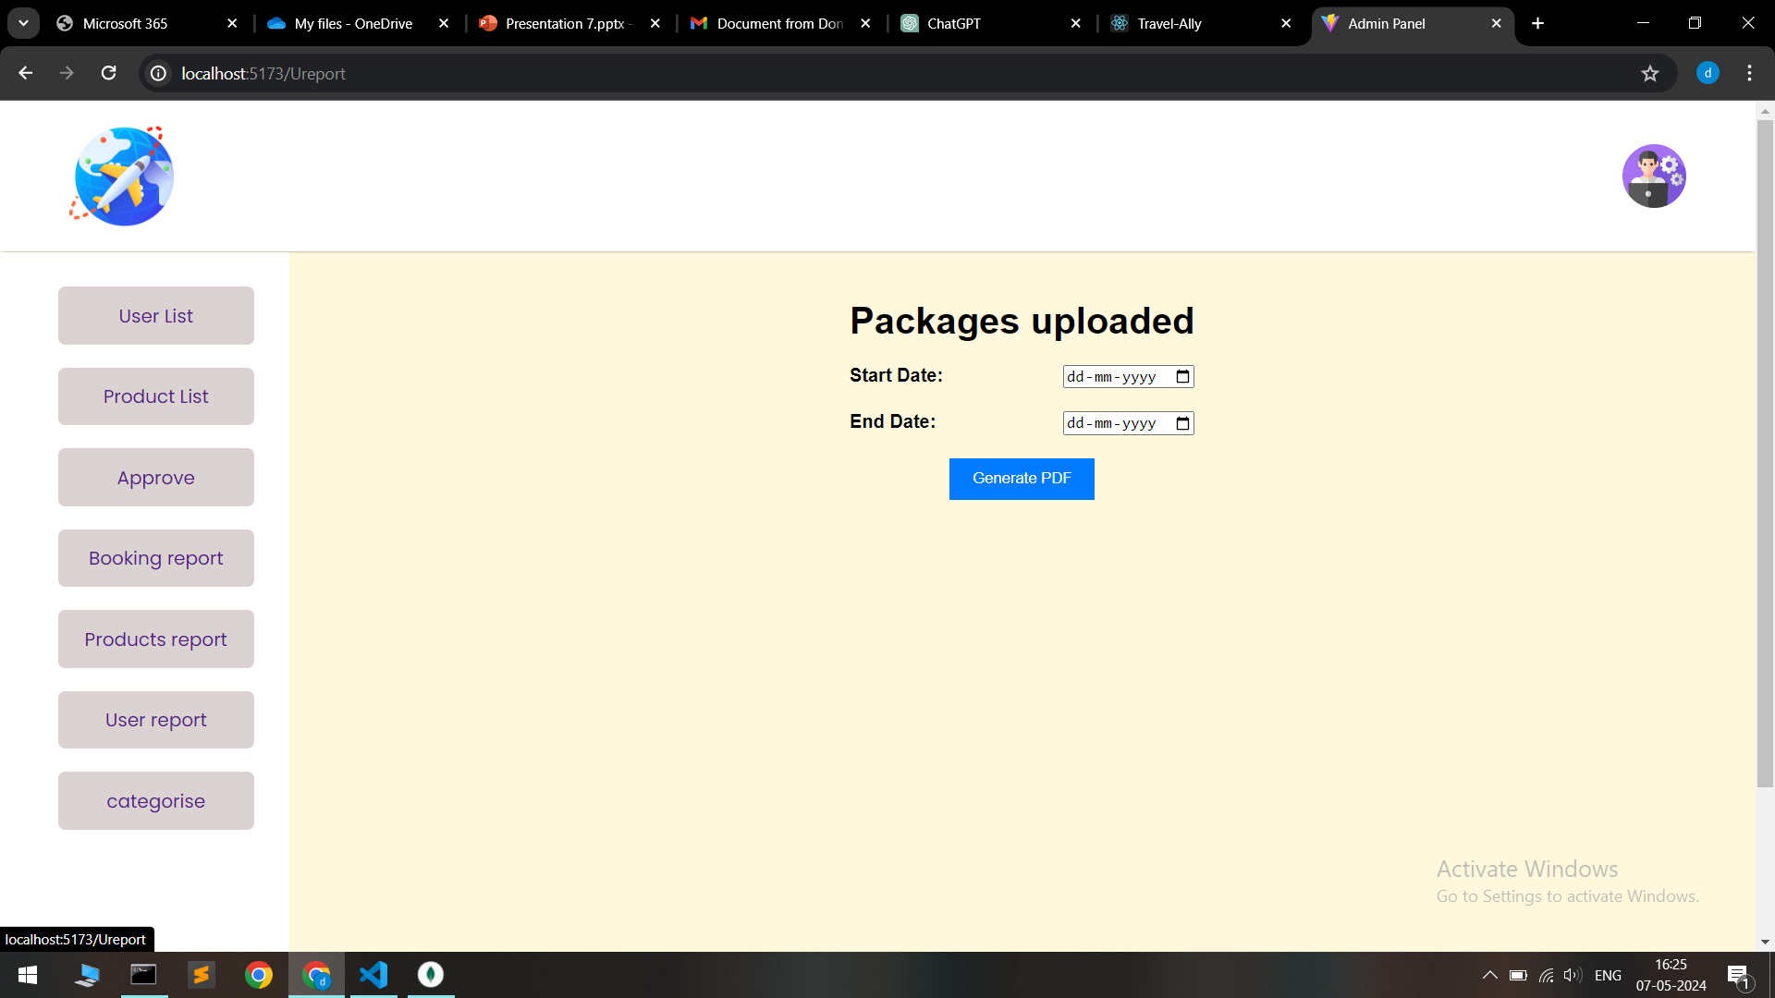
Generate uploaded package report

Slide 17
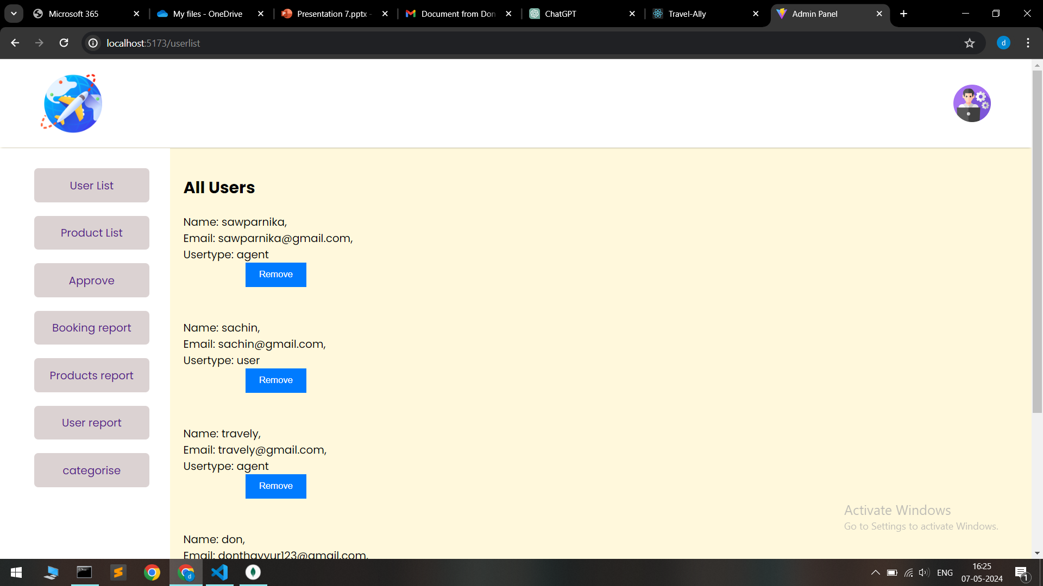
All user list

Slide 18
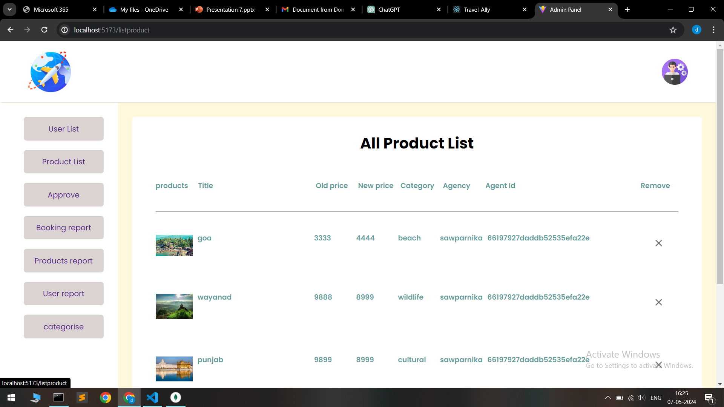
All product list

Slide 19
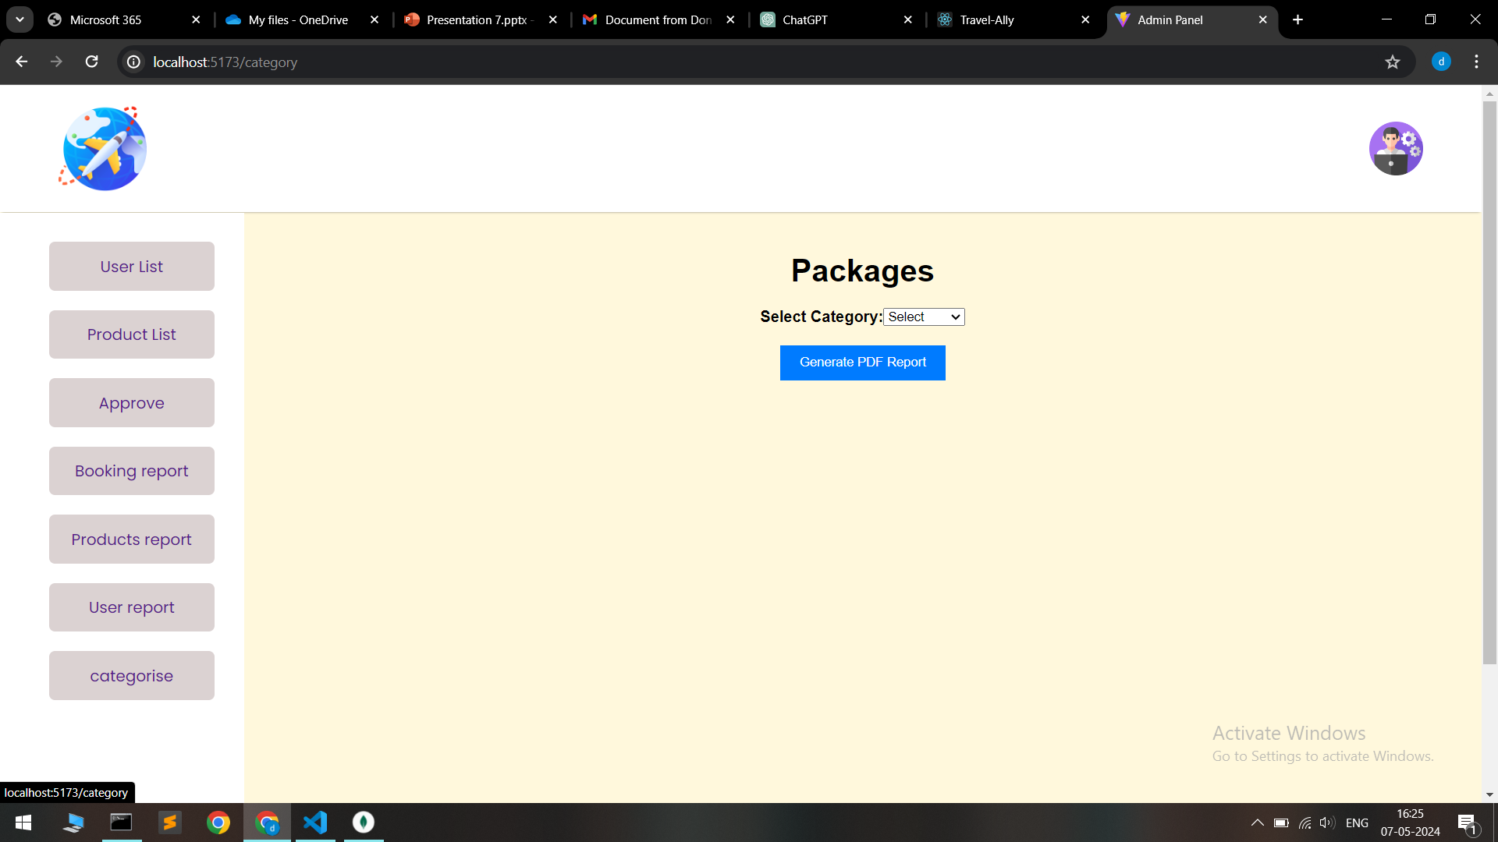
Category wise report

Slide 20

Signup report

Slide 21
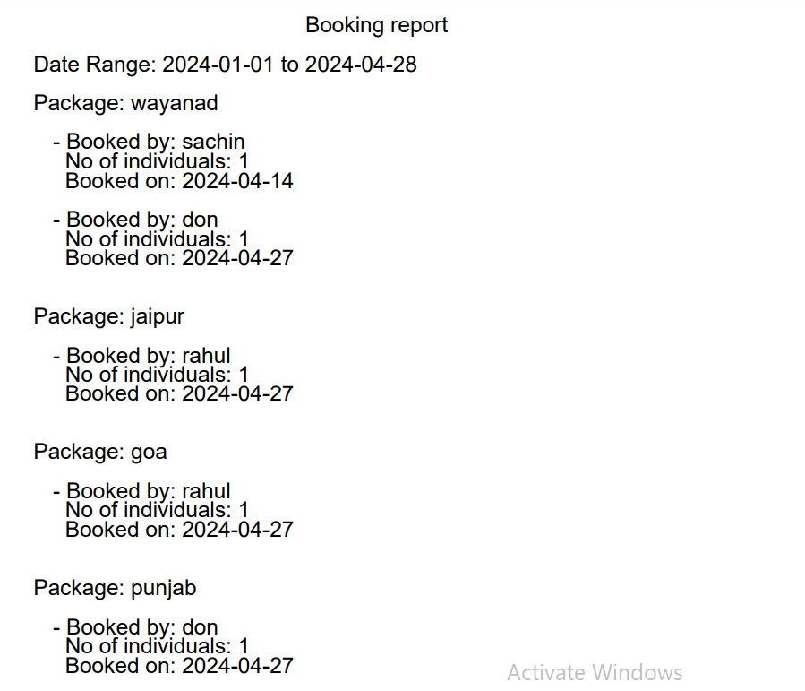
Generated reports

Slide 22
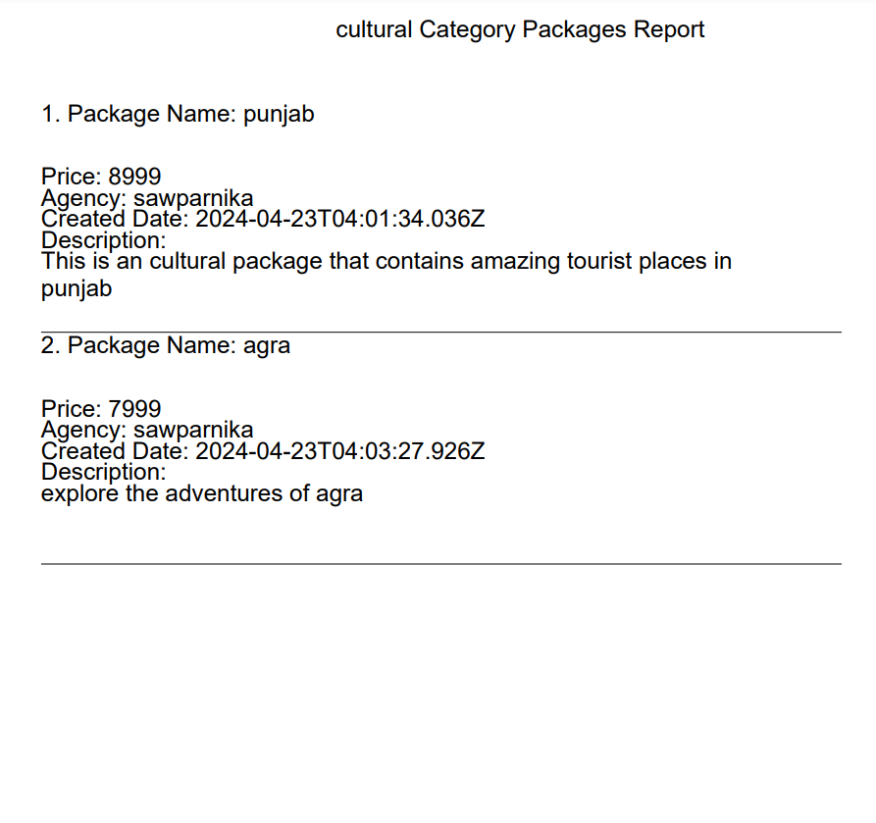

Slide 23
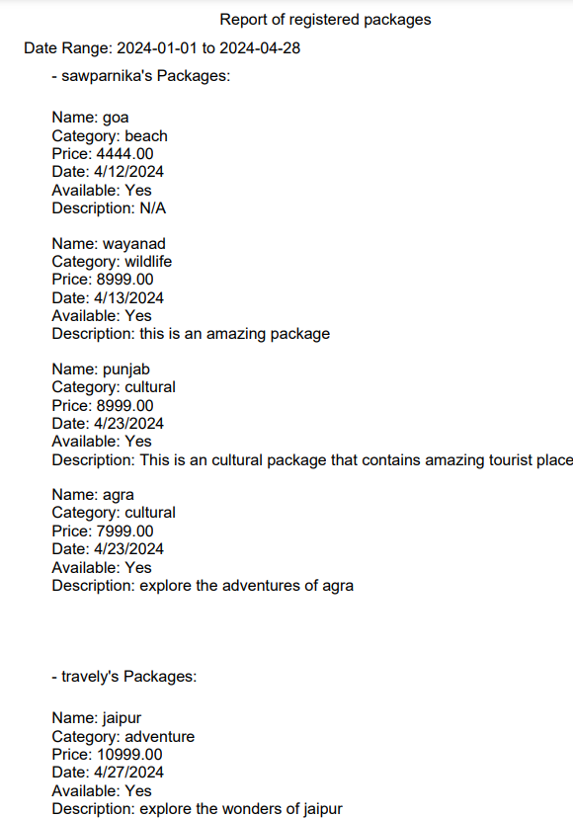

Slide 24
Conclusion
In conclusion, the travel package website project aims to create a user-friendly platform that offers comprehensive information about destinations, accommodations, activities, transportation options, and pricing. By enhancing user experience, providing detailed data, and facilitating seamless bookings, the website intends to become a go-to resource for travelers seeking to plan their trips effectively and enjoy memorable experiences.

Slide 25

Future scope
Mobile App Integration:
Develop a dedicated mobile app that complements the website, offering users a seamless experience across devices. The app can provide features like real-time notifications, offline access to travel information, and easy booking and payment options.

Slide 26

Virtual Reality (VR) Tours:
Incorporate VR technology to offer virtual tours of destinations, accommodations, and attractions. This immersive experience can help users visualize their travel options better and make more informed decisions.
Integration with Social Platforms:
Enable social media integration to allow users to share their travel plans, experiences, and reviews directly from the website. This can also include social login options for a more streamlined user registration process.

Slide 27




THANKYOU

